Slide 1
Basics of Semiconductors
By
Saurav Thakur

Slide 2
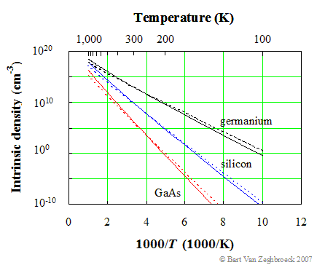
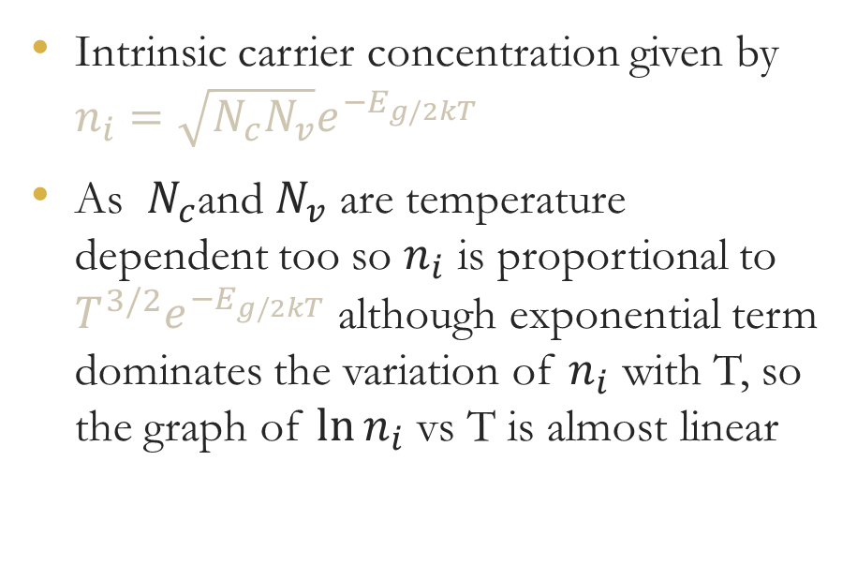
Temperature Dependence of Carrier Concentration
Intrinsic carrier concentration given by $n_{i}=\sqrt{N_{c}N_{v}}e^{{−E}_{g/2kT}}$
As $N_{c}$and $N_{v}$ are temperature dependent too so $n_{i}$ is proportional to ${T^{3/2}e}^{{−E}_{g/2kT}}$ although exponential term dominates the variation of $n_{i}$ with T, so the graph of $\ln{n_{i}}$ vs T is almost linear
Image source ecee.colorado.edu

Slide 3
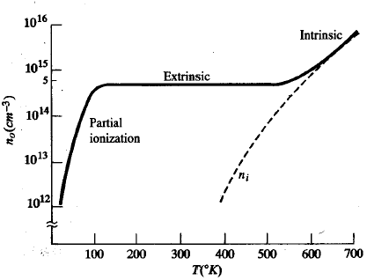
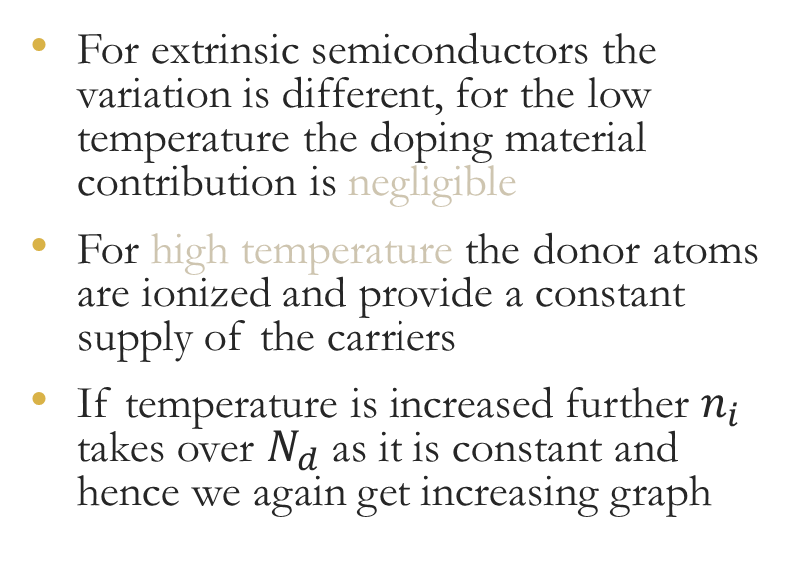
Temperature Dependence of Carrier Concentration
For extrinsic semiconductors the variation is different, for the low temperature the doping material contribution is negligible
For high temperature the donor atoms are ionized and provide a constant supply of the carriers
If temperature is increased further $n_{i}$ takes over $N_{d}$ as it is constant and hence we again get increasing graph
Image source osp.mans.edu.eg

Slide 4
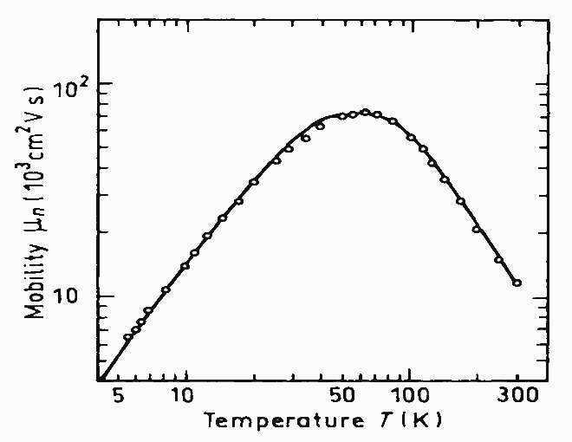
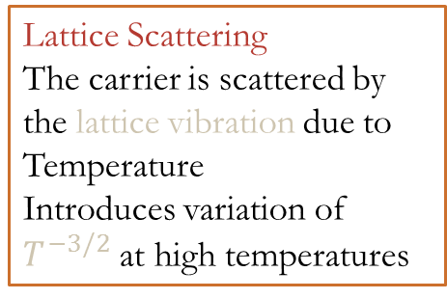
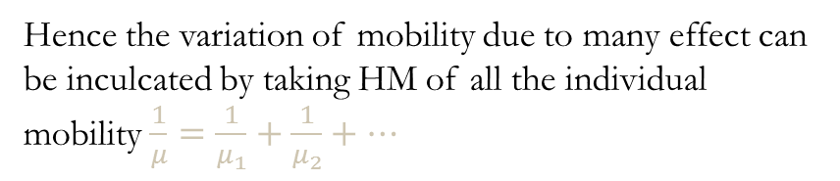
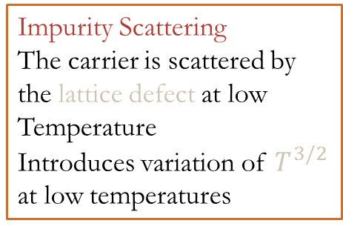
Effect of Temperature and Doping on Mobility
Lattice Scattering
The carrier is scattered by the lattice vibration due to Temperature
Introduces variation of $T^{−3/2}$ at high temperatures
Impurity Scattering
The carrier is scattered by the lattice defect at low Temperature
Introduces variation of $T^{3/2}$ at low temperatures
Hence the variation of mobility due to many effect can be inculcated by taking HM of all the individual mobility $\frac{1}{μ}=\frac{1}{μ_{1}}+\frac{1}{μ_{2}}+…$
Image source ioffe.ru

Slide 5
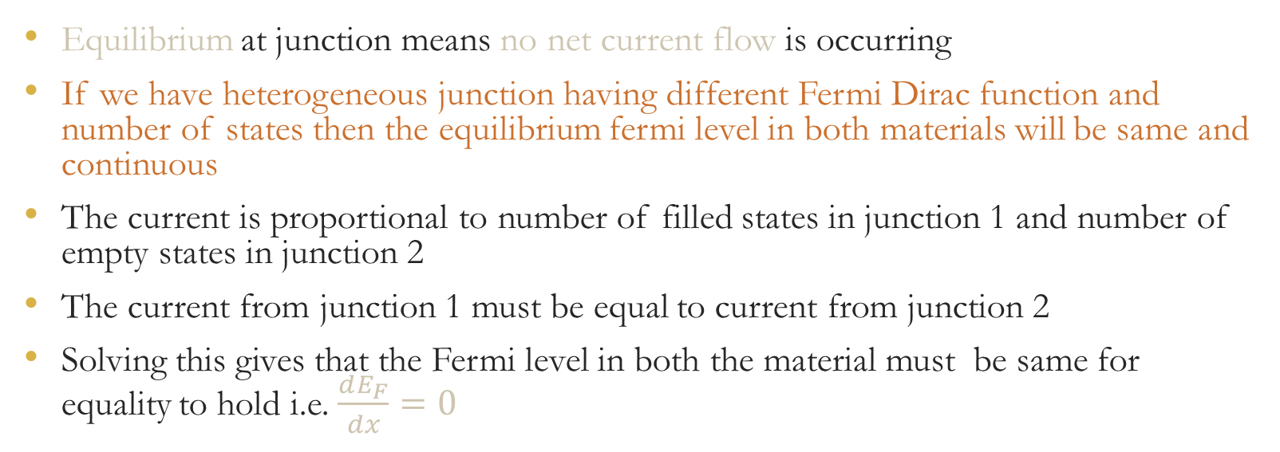
Invariance of Fermi level at equilibrium
Equilibrium at junction means no net current flow is occurring
If we have heterogeneous junction having different Fermi Dirac function and number of states then the equilibrium fermi level in both materials will be same and continuous
The current is proportional to number of filled states in junction 1 and number of empty states in junction 2
The current from junction 1 must be equal to current from junction 2
Solving this gives that the Fermi level in both the material must be same for equality to hold i.e. $\frac{dE_{F}}{dx}=0$

Slide 6
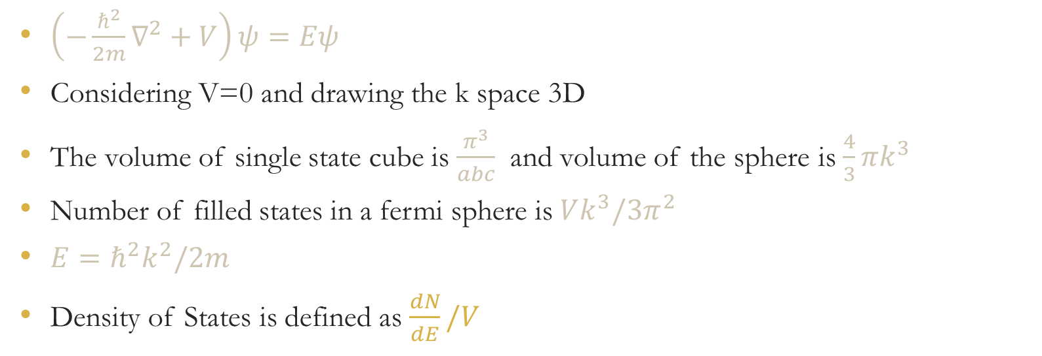
Calculation of Density of States
$\left(−\frac{ℏ^{2}}{2m}∇^{2}+V\right)ψ=Eψ$
Considering V=0 and drawing the k space 3D
The volume of single state cube is $\frac{π^{3}}{abc}$ and volume of the sphere is $\frac{4}{3}πk^{3}$
Number of filled states in a fermi sphere is $Vk^{3}/3π^{2}$
$E=ℏ^{2}k^{2}/2m$
Density of States is defined as $\frac{dN}{dE}/V$

Slide 7
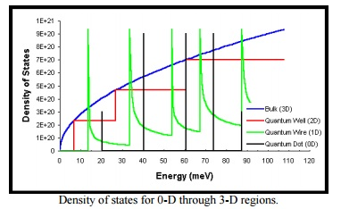
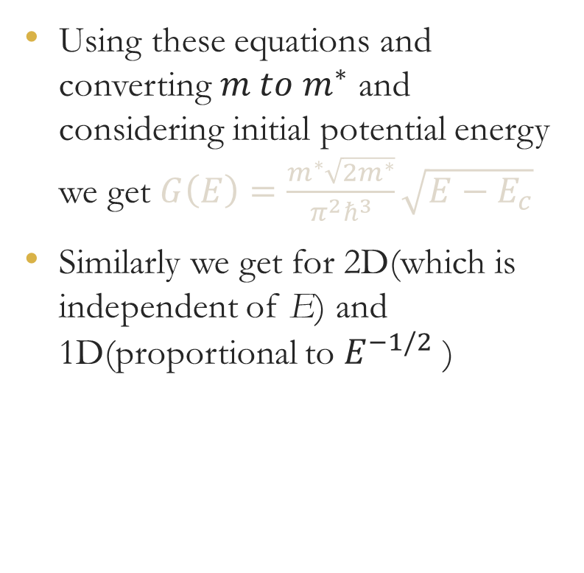
Using these equations and converting $m to m^{∗}$ and considering initial potential energy we get $G\left(E\right)=\frac{m^{∗}\sqrt{2m^{∗}}}{{π^{2}ℏ}^{3}}\sqrt{E−E_{c}}$
Similarly we get for 2D(which is independent of E) and 1D(proportional to $E^{−1/2}$ )

Slide 8
THANK YOU

